Slide 1
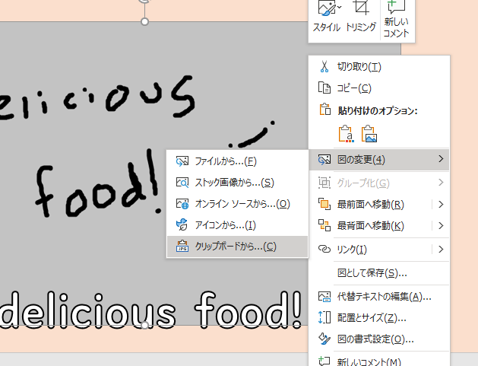
To quickly use this template,
Firstly copy the image you want to insert. (From Google etc.)
Right click on the grey placeholder box and click ‘Replace Image”
Select the bottom option to paste your image in the place of the placeholder image.
By the way
I would advise not to use all the slides but just delete unnecessary ones! I think my students would prefer you give more detail on a few things than no detail on a lot of things! Thank you!

Slide 2

Welcome to...

Slide 3


You can eat...
Name of delicious food!

Slide 4

You can eat...
Name of delicious food!

Slide 5


You can visit...
Name of beautiful place!

Slide 6

You can visit...
Name of beautiful place!

Slide 7


You can see...
Name of thing you can see!

Slide 8

You can see...
Name of thing you can see!

Slide 9


You can buy...
Thing you can buy!

Slide 10
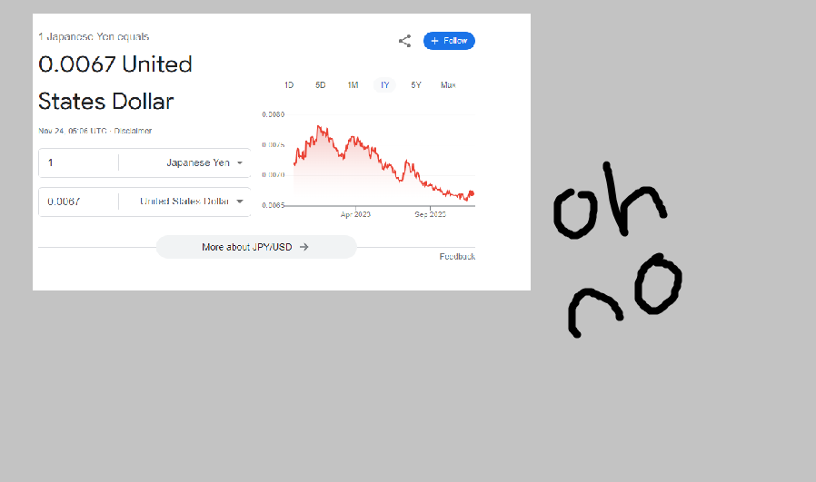
You can buy...
Thing you can buy!

Slide 11


You can enjoy...
Thing you can enjoy!

Slide 12
Thank you!
Do you have any questions?

Slide 13




Others...
You can make...
You can write...
You can wear...
You can drink...

